Slide 1
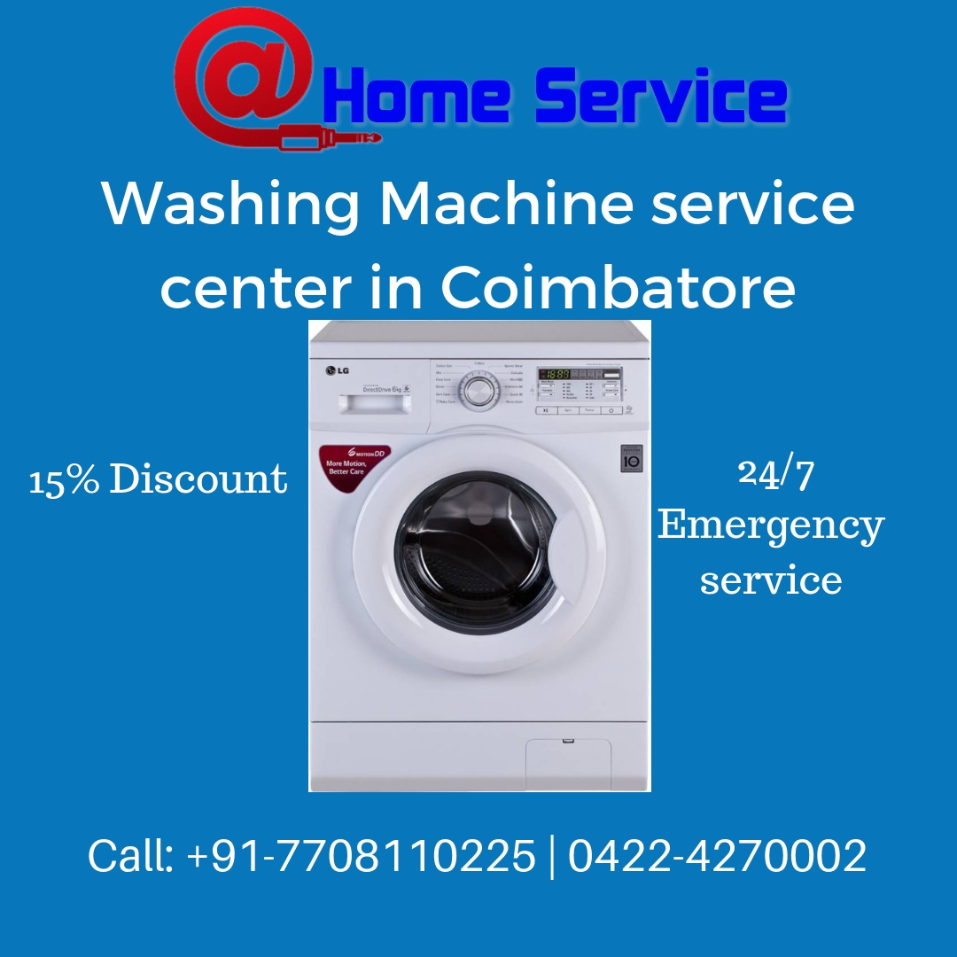
Washing Machine Repair and Service in Coimbatore

Slide 2
Introduction
Well, washing machine is now merely seen in everyone’s home. It is just a machine which needs proper service and maintenance to perform better. So, every person out there would agree no one is ready to waste their precious time washing their clothes manually, which means Washing Machine is the only solution. That’s why it needs a quality service in order to maintain its efficiency a higher rate.

Slide 3
Why At Home Service to repair Washing Machine?
We square measure having quite fifty and talented service engineers for Washing machine service. We provide the service for all national and international brands of laundry machines. Like fully Automatic high Load washer, Automatic Front Load Washer and Semi-Automatic Washer. we tend to tend to supply service and repair all the brands like: Front-Loading Washer, ancient Top-Loading washer, High efficiency (HE) Top-Loading washer, semi-automatic washer, Fuzzy management of Washer, direct drive washer, half-dozen Motion Direct Drive laundry Machines.

Slide 4
Onida Washing Machine Service – AT HOME SERVICE
Onida washing machine is branded product and have a higher rate of efficiency while compared to other products, henceforth the selling rate is more at numbers. Most probably the problems won’t occur but in case there are several basic problems that may occur in a while,
Water leaking
Washers not working
Unwanted Noise
Washing machine shaking and moving
Sometimes High Consumption of electricity
If these problems occurs just ping to AT HOME SERVICE, the most familiar Onida washing machine repair and service center in Coimbatore.

Slide 5
Whirlpool Washing Machine Repair – At Home Service
Yeah, the whirlpool washing machine is not less than Onida brand. Both perform at the level of their standards. In case of any emergency service required don’t wait, create a decision or contact our client care service. They going to fix your issues and provide service quickly and take care of your Whirlpool Washing Machine free from troubles. We have a tendency to repair all kinds of like Top Loader, Front Loader and Semi-Automatic washing machine. And we provide a repair and service for all Whirlpool products. Like washer, white goods, ac, TV and small wave kitchen appliance

Slide 6
Call us on any time
We conjointly give emergency service for those days after you would like it most! Whether it’s a vacation or not, weekend, or within the middle of the night, a ping to reception Service to repair your any natural philosophy unit at threshold service. Our 24/7 emergency repair service will guarantee to repair and repair your home items as low as possible.

Slide 7
Conclusion
Don’t hesitate to reach or call At home service center for any kind of washing machine repair and installation. The service will be genuine and quality manner. Not only whirlpool and Onida they service all other types and brand of all washing machines like Godreg, TCL, Akai, Hitachi and so on…

